Slide 1
Introduction to Web Technologies
Objects, Functions & Conditionals
Lecturer: Christen Cao

Slide 2
Summary
Overview
Introduction to HTML
Tags, attributes, class/ID selector, CSS etc.
Introduction to JS
Input/output: prompt(…), alert(…);
Variable var & data types
– Variables：arithmetic operators: +
- * / % (modulo)
Conversion (strings -> numbers): Number(…); parseInt(...)
Math object: Math.sqrt(...), round(...), ceil(...), floor(...),
max(...,...), min(...,...), PI
This
Lesson!

Slide 3
Content
Object, Function & Expression
Conditionals & Relation
Number Systems

Slide 4

Topic 1: Object, Function & Expression

Slide 5
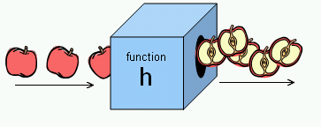
Functions and why?
identifier(parameter1, parameter2, …)
Function performs a specific task or procedure.
The task is to be carried out at multiple places for
multiple times
The task (procedure) is defined by experts and can be used by multiple people
Modularity: modular programming

Slide 6
Q&A: Object-oriented Programming (OOP)
Uses classes and objects to create models based
on the real world environment.
Easy to maintain and modify existing code as new objects are created inheriting characteristics from existing ones
Easy to understand the program after development with well designed classes, objects and their methods and properties.
Efficiency: add new or destroy unused objects/ classes easily

Slide 7
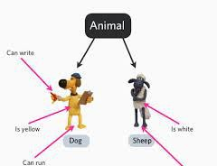
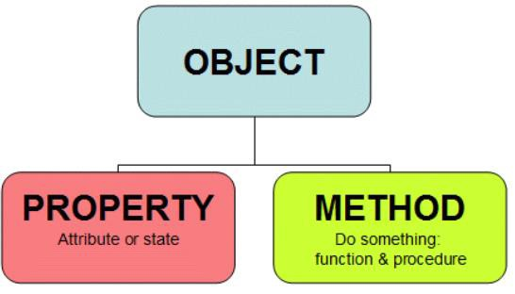
Q&A: Class/Object & JS
Class: a convenient way to abstract sets of objects with
common properties
"object" refers to a particular instance of a class
“object” can be containers of functions (methods), properties
(constants).
JS supports objects even without classes (OOP type)

Slide 8
Q&A: Procedure programming vs OOP
Procedure programming
Solving a problem from top of the code down to the
bottom
Statements start with strong verb
startCoffeeMachine(coffeemachineA);
washCoffeeMachine(coffeemachineB);
OOP
Solving a problem through objects
Statements start with the object to be manipulated
coffeemachineA.start(); coffeemachineB.wash();

Slide 9
Math.function( )
“Math” object: Container of math functions & constants.
Math.abs(x)
Math.sqrt(x)
Math.exp(x): E^{x}
Math.pow(x,n): x to the power n
Math.round(x), Math.ceil(x), Math.floor(x)
Math.max(...,...), Max.min(...,...)
Math.random() // [0,1)

Slide 10
Math.constant
Math.PI
returns PI, 3.14….
Math.SQRT2
returns 1.414…the square root of 2
Math.E
returns Euler's number 2.718…
It is just a value, so no brackets () are needed.

Slide 11
Expression
A legal combination of :
Value(s)
Variable(s)
Function call(s)
Operators
An expression represents a value
Used in a statement where a value is expected
Notes:
The values can be of various types, such as numbers and strings.

Slide 12
Expression Examples
For example, 5 * 10 evaluates to 50:
5*10 → 50
Expressions can also contain variable values:
var x;
x = 5;
x * 10 → 50
The values can be of various types, such as numbers and strings.
"John" + " " + "Doe” → "John Doe"
Notes:
→ : Evaluates to

Slide 13
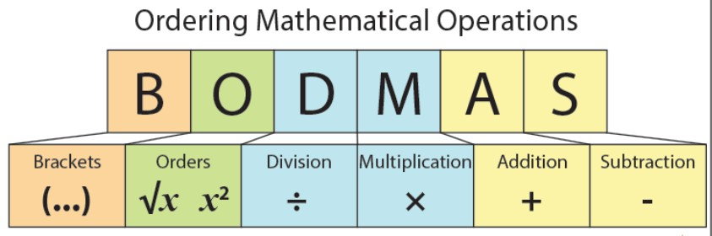
Evaluation sequencing
Nested functions: inner functions/brackets first
Follows the precedence of the operators BODMAS
Use () when not sure

Slide 14
Try out : how does it work ?
If we enter 5:
alert(3+2+prompt(“Enter a number"));
alert(3+(2+prompt(" Enter a number")));
alert(3+Number(2+prompt(" Enter a number")));
Enter 5: 55
Enter 5: 325
Enter 5: 28

Slide 15
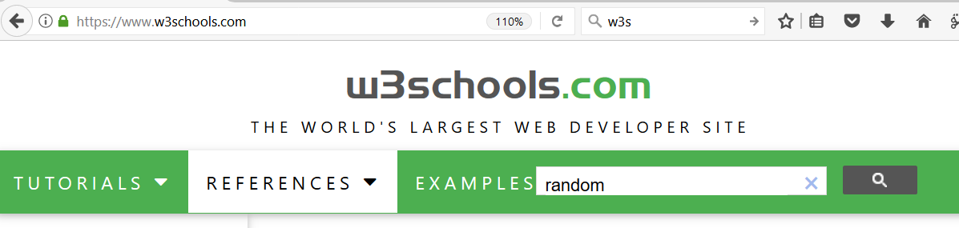
Try out:
Generate 8 random numbers between 0-10.
for(i=1; i<=8; i++) {
alert(Math.round(10*Math.random()));
}

Slide 16
Topic 2: Conditionals & Relation

Slide 17
Conditions

Slide 18


Conditions: if (…)…;
Decisive Programs: Branching / Selection
Begin Statement
if ( )
if true – S tatement
End Statement

Slide 19
Conditions: if (…) … else …;
Decisive Programs: Branching / Selection
Begin Statement
if ( )
else
if true - Statement
if false - Statement
End Statement

Slide 20
if (…) {… ;} else {…;}
if ( test ) { do-this-statement; }
if(x >0 ) {alert(“a positive number.”);}
Alternatives:
If ( test ) {do-this-statement;}
else {do-the-other-statement; }
var x=15;
if (x>0) {
alert(“a positive number.”);}
else {
alert(“it is <=0”);}

Slide 21
Relational operators
Finding relationships between values:
what is the opposite operator to “x<0” ?
== equal
!= unequal
< less than
<= less than or equal
> greater than
>= greater than or equal

Slide 22
Try out: Relational operators
== equal
=== strict equal
!= unequal
!== strict unequal
< less than
<= less than or equal
> greater than
>= greater than or equal
Compare numbers, characters, or
strings
ASCII (American Standard Code for Information Interchange) here
var x = 2; alert(x==2); alert(x>=0); alert(x!=2);
var x = 'a';
alert(x=='a');
alert(x>='b');
alert(x!='p');
alert('abc' == 'abc');
alert('abd' >= 'abc');
alert('aba' >= 'abc');
alert('abc' > 'ab');
alert(3 > 'abc');
Notes:
ASCII is pronounced as as-key.

Slide 23

Is a letter before or after “a” in Ascii?
var c=prompt("enter a letter:");
if(c<'a’) {
alert( c + " is before 'a' in Ascii"); }
Else {
alert( c + " is after 'a' in Ascii"); }
Ascii table: space … 0-9 …. A-Z
… a-z

Slide 24
Anything wrong?
var name=prompt("enter your name: ");
if(name="Mike") {
alert("Hi Mike" ); }
Else {
alert("it is not Mike"); }

Slide 25
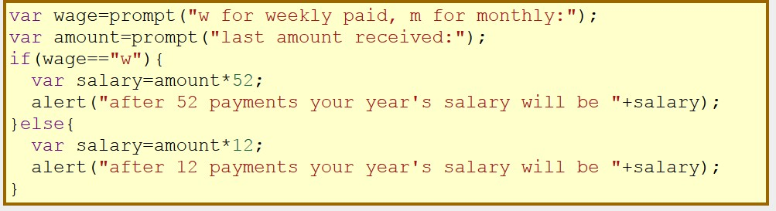
Compound Statements
if(...) {stmt1; stmt2; ...stmtn;}
if(...){...;...;} else {...;...;}
a sequence of single statements enclosed in curly braces
forms a compound statement.

Slide 26
Nested Conditionals
Begin Statement
if ( )
else
if ( )
else
if true - Statement
(nested) if true - Statement
Statement
End Statement

Slide 27
Nested Conditionals
Writing an if statement in another if statement is
called nesting.
• if(...){ if(...) ... } else { if(...) ... }

Slide 28
var x=15;
if (x<0) {
alert(" negative number"); }
else if (x>0) {
alert(“positive number"); }
else {
alert("it is 0 "); }
alert ("end");
Try out: Is x positive / negative?

Slide 29
var x=15;
if (x > 20) {
alert("x is bigger than 20"); }
else if (x > 10) {
alert(“x is bigger than 10 and less than 20"); }
else {
alert("x is equal to or smaller than 10"); }
alert ("end");
Try out: Is x bigger than 20?

Slide 30
Try: string functions
Strings are indexed from 0 !
A string of length n has characters indexed from 0
to n-1.
s.length
s.substr( start, length )
s.substring( from, upto ) // exclue the upto s.indexOf(subs), s.lastIndexOf(subs) s.indexOf(subs, from), s.lastIndexOf(subs, from) s.charAt() -> s.charAt(s.length-1) s.toUpperCase(), s.toLowerCase()
More info: JavaScript String Methods

Slide 31

Summary
Overview
Introduction to HTML
– Tags, attributes, class/ID selector,
CSS etc.
Introduction to JS
– Input/output, variables, arithmetic operators, math object, string functions
Conditionals
• if (...) … ; else ...;
Relational operators: ==, !=, >, >=,
<, <=
Lecture
Practice !

Slide 32
Topic 3: Number Systems

Slide 33
Number systems
Integer number
An integer (more commonly called an int) is a number without a decimal point
-2, 0, 500, 1024, etc.
Float number
A float is a floating-point number, which means it is a number that has a decimal place. Floats are used when more precision is needed
4.0, 3.1415, 0.000001, etc.

Slide 34
alert(…): single or double quotes ?
Output:
She says: “Hello!”
alert(‘She says "Hello" '); alert(“She says: 'Hello' ");
Escape character \'quote\' alert("Say \" Hello \" ");
alert('Say \'Hello\' ');
Which way is easy, popular or powerful !
JSON only allows double quotes.
Notes:
JSON (JavaScript Object Notation) is a lightweight data-interchange format.
it uses human-readable text to store and transmit data objects consisting of attribute–value pairs and arrays.
It is a common data format with diverse uses in electronic data interchange, including that of web applications with servers.

Slide 35
Anything wrong ?
var x=2;
if(x==2)
{ alert("it is 2 " )} ;
else
alert("it is not 2");
{ alert("it is 2 " ) ;}
if(...) {stmt1; stmt2; ...stmtn;} if(...){...;...;} else {...;...;}

Slide 36
Alignment, indentation, paired brackets …
if(0) alert('a'); else{ if(0) alert('b'); else alert('c') } How to make it easy to read and check?
if(0) {
alert('a’);
}
else{
if(0) {
alert('b’);
}
else {
alert('c’);
}
}
c

Slide 37
Are they equivalent? If not, which one is correct?
var x = 4;
if(x >= 0) {
if(x==0) {alert("x equals to 0");}
else {alert("x is greater than 0");
}
var x = 4;
if(x >= 0) {
if(x==0) {
alert("x equals 0");
}
else {
alert("x is greater than 0");
}
}

Slide 38
Are they equivalent? If not, which one is correct?
var x = -1;
if(x >= 0){
if(x==0)alert("x equals 0");
}
else alert("x is greater than 0");

